Slide 1
TECHNICAL WRITING- II
HS 513

Slide 2
Clarity
Unclear Structures
peter’s hair needs cutting badly.
Peter’s hair badly needs cutting.
he telephoned asking me to come next Sunday today.
He telephoned today asking me to come next Sunday.
the basket was carried by a girl full of flowers.
The basket which was full of flowers was carried by a girl.

Slide 3
Cohesive Devices
words or phrases that help to connect your ideas and make your writing more coherent and logical
linking words, connectors, or discourse markers
show the relationship between sentences, paragraphs, or sections of a text or speech.

Slide 4
Adding Information
And: This is the most common way to join two sentences or clauses that have the same importance. For example: She likes reading and writing.
Also: This can be used to add another point that is similar or related to the previous one. For example He is good at math. He also excels in science.
As well as: This can be used to add another noun or noun phrase that is similar or related to the previous one. For example: She speaks English as well as French.
Too: This can be used at the end of a sentence to add another point that is similar or related to the previous one. For example: He likes coffee. I like it too.
Furthermore / Moreover / In addition: These can be used to add another point that is more important or stronger than the previous one. They are usually used at the beginning of a sentence or paragraph. For example: The project was delayed due to technical issues. Furthermore, the budget was exceeded by 20%.
Along with / Together with / Alongside: These can be used to add another noun or noun phrase that is related to the previous one and shows a connection or contrast. For example: The report was submitted along with a summary of the findings.

Slide 5
Sequencing Information
Firstly / Secondly / Thirdly / Finally: These can be used to introduce your main points or arguments in a logical order. They are usually used at the beginning of a sentence or paragraph. For example: Firstly, I will explain the background of the issue. Secondly, I will present some possible solutions. Thirdly, I will evaluate their advantages and disadvantages. Finally, I will give my opinion and recommendation.
Next / Then / After that / Subsequently: These can be used to show the chronological order of events or actions. They are usually used at the beginning of a sentence or paragraph. For example: Next, we will discuss the methodology of the research. Then, we will analyze the data and results. After that, we will draw some conclusions and implications. Subsequently, we will make some recommendations for future research.
Before / After / During / While: These can be used to show the time relationship between two events or actions. They are usually used as prepositions followed by a noun or a clause. For example: Before we start the presentation, please turn off your phones. After she finished her degree, she got a job in a multinational company. During the meeting, he raised some important questions. While he was driving, he saw an accident.
Meanwhile / Simultaneously: These can be used to show that two events or actions happen at the same time but in different places or situations. They are usually used at the beginning of a sentence or paragraph. For example: Meanwhile, in another part of the city, a fire broke out in a factory. Simultaneously, scientists from different countries were working on a vaccine for the virus.

Slide 6
Emphasizing Information
Above all / Most importantly: These can be used to introduce the most important point or argument in your writing. They are usually used at the beginning of a sentence or paragraph. For example: Above all, you should practice your writing skills regularly. Most importantly, you should follow the instructions of the task carefully.
Especially / Particularly / Specifically: These can be used to emphasize a specific point, example, or detail that is relevant or important. They are usually used after a noun or a verb. For example: She enjoys reading books, especially novels. He is particularly good at solving problems. They specifically asked for your opinion.
Indeed / In fact / Actually: These can be used to emphasize a point that is true or surprising. They are usually used at the beginning or in the middle of a sentence. For example: Indeed, he is one of the best writers in the world. She is very smart, in fact, she has a PhD in physics. He actually likes broccoli.

Slide 7
Contrasting Information
But / However / Nevertheless / Nonetheless: These can be used to introduce a point that is different from or opposite to the previous one. They are usually used at the beginning of a sentence or after a comma. For example: She likes reading but hates writing. He is rich, however, he is not happy. She failed the exam, nevertheless, she did not give up. He was tired, nonetheless, he continued working.
On the other hand / On the contrary / Conversely: These can be used to introduce a point that is different from or opposite to the previous one, especially when comparing two situations or perspectives. They are usually used at the beginning of a sentence or paragraph. For example: Some people think that technology has improved our lives. On the other hand, some people think that it has made us more isolated. He claimed that he was innocent. On the contrary, the evidence proved that he was guilty. Women tend to live longer than men. Conversely, men tend to earn more than women.
Although / Even though / Though / Despite / In spite of: These can be used to introduce a point that is different from or opposite to the previous one, but does not change the main idea or argument. They are usually followed by a noun or a clause. For example: Although he was sick, he went to school. Even though she studied hard, she failed the exam. Though it was raining, they decided to go out. Despite his age, he is very active. In spite of the traffic, they arrived on time.

Slide 8
Giving example or evidence
For example / For instance / To illustrate: These can be used to introduce a specific example or instance that illustrates your point or argument. They are usually followed by a noun or a clause. For example: There are many benefits of exercise. For example, it can improve your mood and health. Some animals are endangered due to human activities. For instance, poaching and deforestation threaten the survival of elephants and tigers. He is very talented in music. To illustrate, he can play several instruments and sing.
Such as / Like / Including: These can be used to introduce one or more examples that belong to a category or group that you have mentioned. They are usually followed by a noun or a noun phrase. For example: There are many types of fruits, such as apples, bananas, and oranges. Some sports, like soccer and basketball, require teamwork and coordination. He has visited many countries, including France, Germany, and Italy.
According to / Based on / In terms of: These can be used to introduce evidence or information that comes from a source or a criterion that you have mentioned. They are usually followed by a noun or a noun phrase. For example: According to a recent survey, most people prefer online shopping over traditional shopping. Based on his performance, he deserves a promotion. In terms of quality, this product is superior to others.

Slide 9
Explaining Results or Consequences
As a result / Consequently / Therefore / Thus: These can be used to introduce a result or consequence that follows from a cause or reason that you have mentioned. They are usually used at the beginning of a sentence or paragraph. For example: He failed to submit his assignment on time. As a result, he lost 10% of his marks. She studied hard for the exam. Consequently, she passed with flying colors. They did not have enough money to buy food. Therefore, they had to borrow from their neighbors. He was late for the meeting. Thus, he missed an important opportunity.
For this reason / Because of this / That is why: These can be used to introduce a result or consequence that follows from a cause or reason that you have mentioned. They are usually used at the beginning of a sentence or paragraph. For example: He was allergic to peanuts. For this reason, he avoided eating them. She was very tired after working all day. Because of this, she fell asleep on the couch. They had a lot of homework to do. That is why they could not go to the party.
So / Then: These can be used to introduce a result or consequence that follows from a cause or reason that you have mentioned. They are usually used in the middle of a sentence after a comma. For example: He forgot his keys, so he had to break the door. She was hungry, then she ordered a pizza.

Slide 10
Proving Reasons
Because / Since / As: These can be used to introduce a cause or reason for something that you have mentioned. They are usually followed by a clause. For example: He quit his job because he was unhappy. Since it was raining, they decided to stay home. As he was sick, he could not attend the class.
Owing to / Due to / Because of: These can be used to introduce a cause or reason for something that you have mentioned. They are usually followed by a noun or a noun phrase. For example: Owing to his hard work, he achieved his goals. Due to the bad weather, the flight was cancelled. Because of her kindness, everyone loved her.
In order to / So as to / So that: These can be used to introduce a purpose or intention for something that you have mentioned. They are usually followed by a verb or a clause. For example: In order to pass the exam, he studied hard. She left early so as to avoid the traffic. He turned off the lights so that he could sleep.

Slide 11
Conclusion/Summarization
In conclusion / To conclude / To sum up: These can be used to introduce the final paragraph or sentence of your writing where you restate your main points or arguments and give your opinion or recommendation. They are usually used at the beginning of a sentence or paragraph. For example: In conclusion, I believe that technology has more benefits than drawbacks for society. To conclude, I would like to thank you for your attention and cooperation. To sum up, there are three main reasons why I prefer online shopping over traditional shopping.
In short / In brief / In summary: These can be used to introduce a short summary of your main points or arguments in your writing. They are usually used at the beginning of a sentence or paragraph. For example: In short, he is a great leader and a role model. In brief, the project was successful and met all the objectives. In summary, there are many factors that influence consumer behavior.
All in all / Overall / On the whole: These can be used to introduce a general evaluation or assessment of your main points or arguments in your writing. They are usually used at the beginning of a sentence or paragraph. For example: All in all, it was an enjoyable and memorable experience.Overall, I think that this is a good product and worth buying. *On the whole, I agree with the author’s point of view and arguments.*

Slide 12
EXERCISE
Fill in the blanks using AND, SO, BECAUSE, BUT or OR. 1. I could not go out last night _____ I was too busy. 2. I could not go with my friend _____ he went without me. 3. My friend went to the cinema to see a film _____ the film wasn't very good. 4. The cinema was full of people _____ they were all smoking. 5. I like people ____ I don't like smoke. 6. Do you want an orange juice ____ a guava juice? 7. It was my birthday _____ he didn't send me a card. 8. I didn't write to him _____ he didn't write to me. 9. We couldn’t contact him _____ we didn’t have his number. 10. The new department store is now open _____ it is offering big discounts.

Slide 13
Answers
1. because
2. so
3. but
4. and/ but
5. but
6. or
7. and/but
8. because
9. because
10. and

Slide 14
Formal and Informal Language
depending on the reader (Audience) and reason for writing (Purpose).
The tone, the choice of words and the way the words are put together vary between the two different styles.
Formal language is less personal
does not use colloquialisms, contractions or first-person pronouns such as “I” or “We”.
Informal language is more casual and spontaneous
It is used when writing personal emails, text messages and in some business correspondence.
The tone of informal language is more personal than formal language.

Slide 15
Examples
Contractions
Informal:The improvements can’t be made due to budget cuts.
Formal: Improvements cannot be made due to budget restrictions.
Phrasal Verbs
The balloon was blown up for the experiment.
The balloon was inflated for the experiment
Slang/Colloquialism
Professors still count on students to use correct grammar and punctuation in essays.
Professors expect students to use correct grammar and punctuation in essays.
First Person Pronouns
I considered various research methods for the study.
Various research methods were considered for the study.
During the interview we asked the applicants for a personal reference.
During the interview applicants were asked to provide a personal reference.

Slide 16
Gender Neutral language or inclusive language
it demonstrates respect for people of all backgrounds, genders, and beliefs, and it includes everyone in the conversation.
Businessman → Businessperson, business representative
Chairman/chairwoman → Chairperson, chair
Foreman → Foreperson
Salesman → Salesperson
Manpower → Workforce, workers
Mailman → Letter carrier, postal worker
Manned → Crewed

Slide 17
Stewardess → Flight attendant
Maid → Housekeeper
Granddaughter/Grandson → Grandchild
Husband/wife → Spouse, partner
Fireman → Firefighter
Congressman → Legislator
Freshman → First-year student
Upperclassman → Third-year, fourth-year, etc.
Man-made → Synthetic

Slide 18
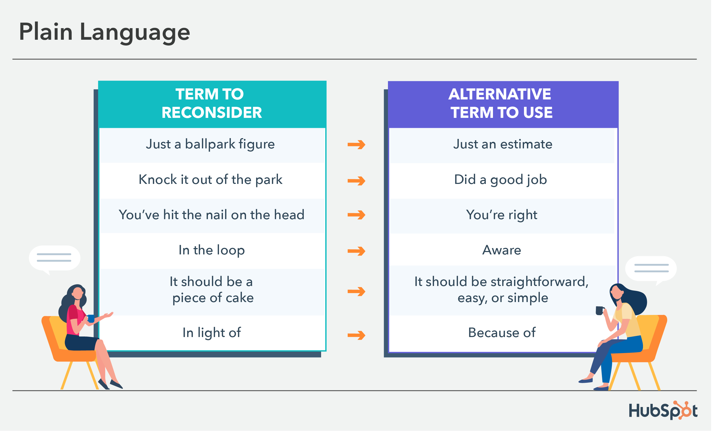
Samples

Slide 19
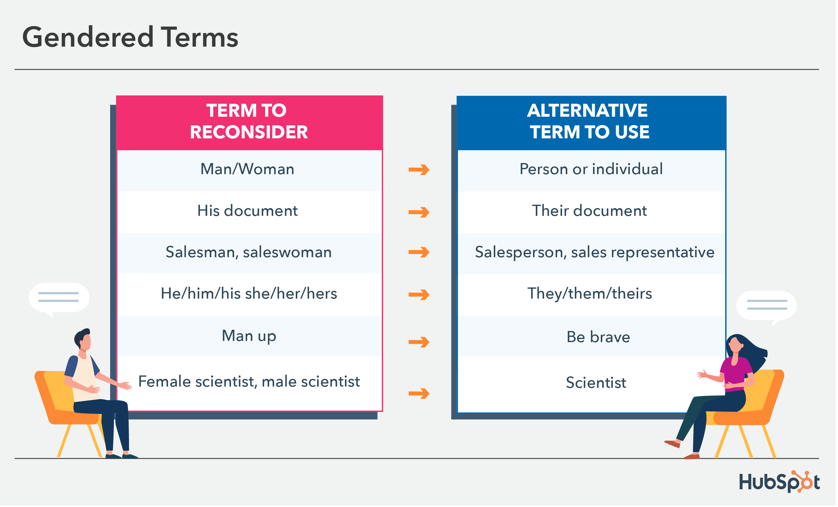
Terms

Slide 20
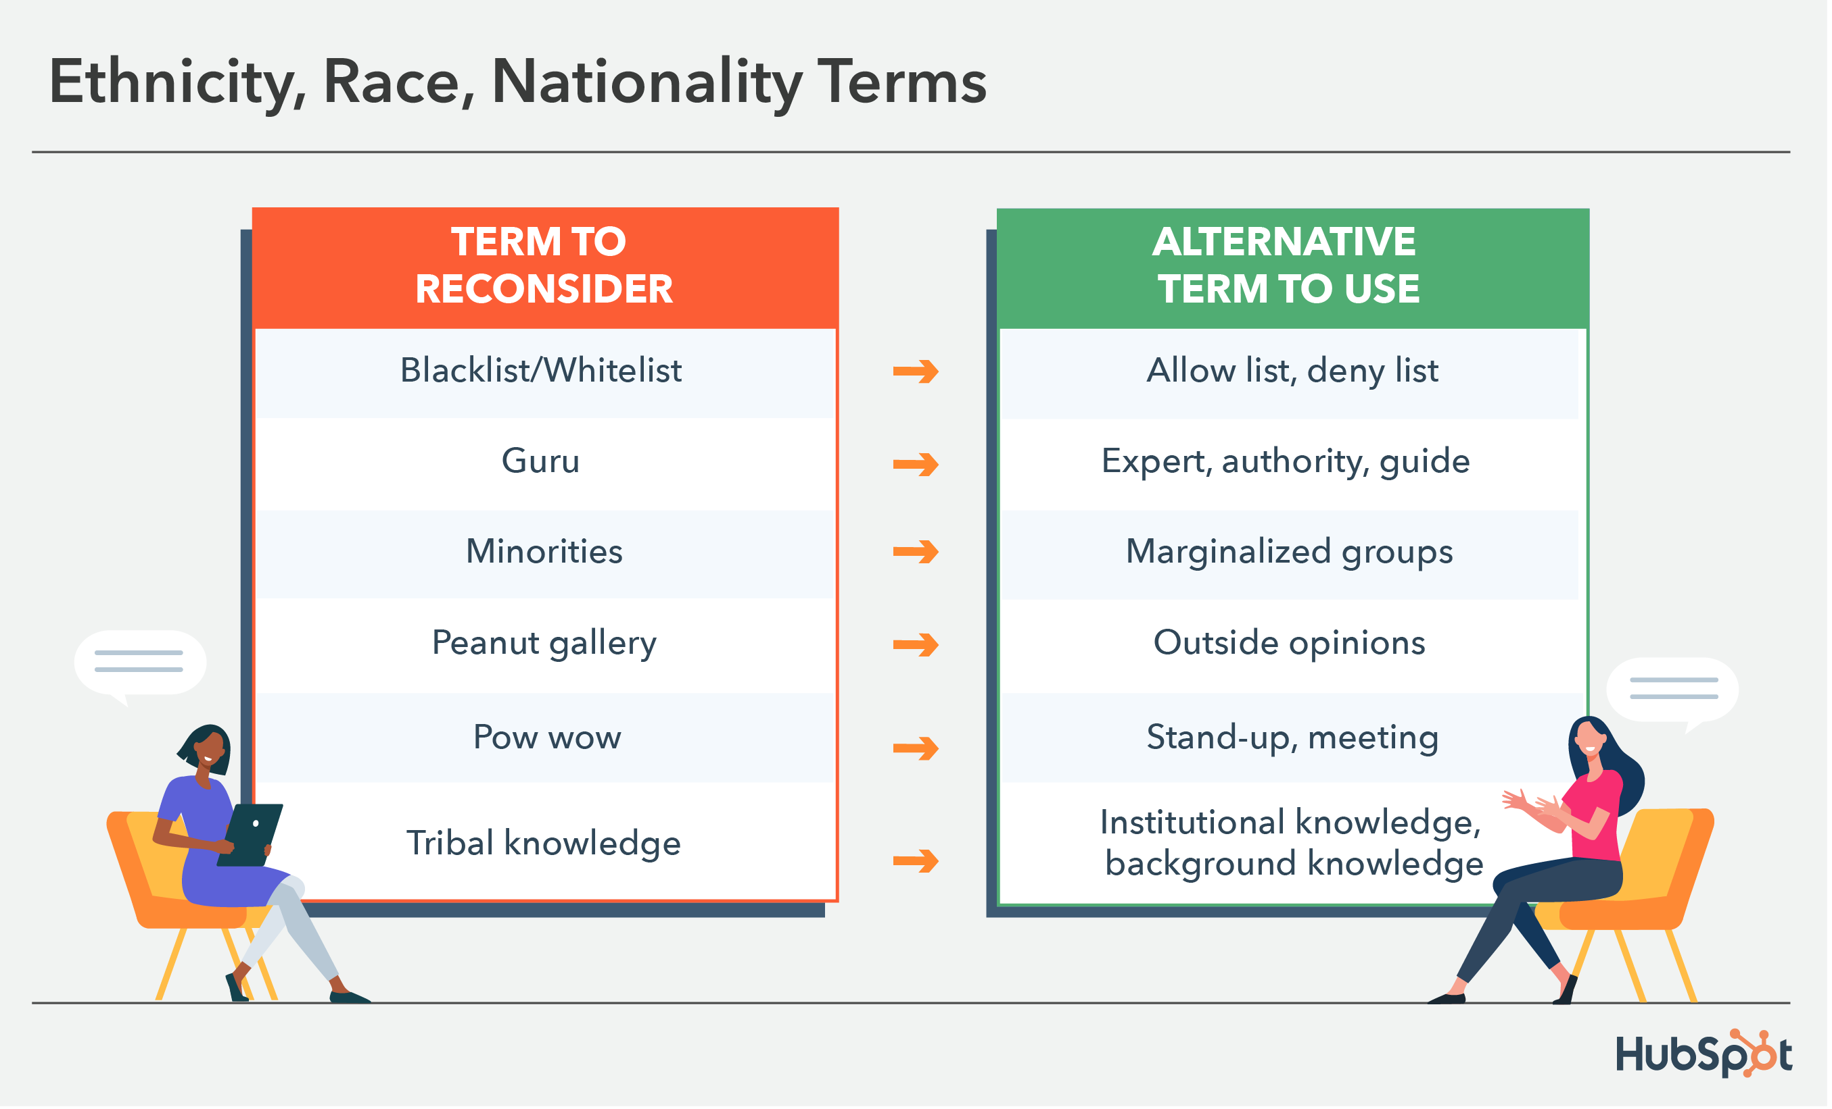

Slide 21
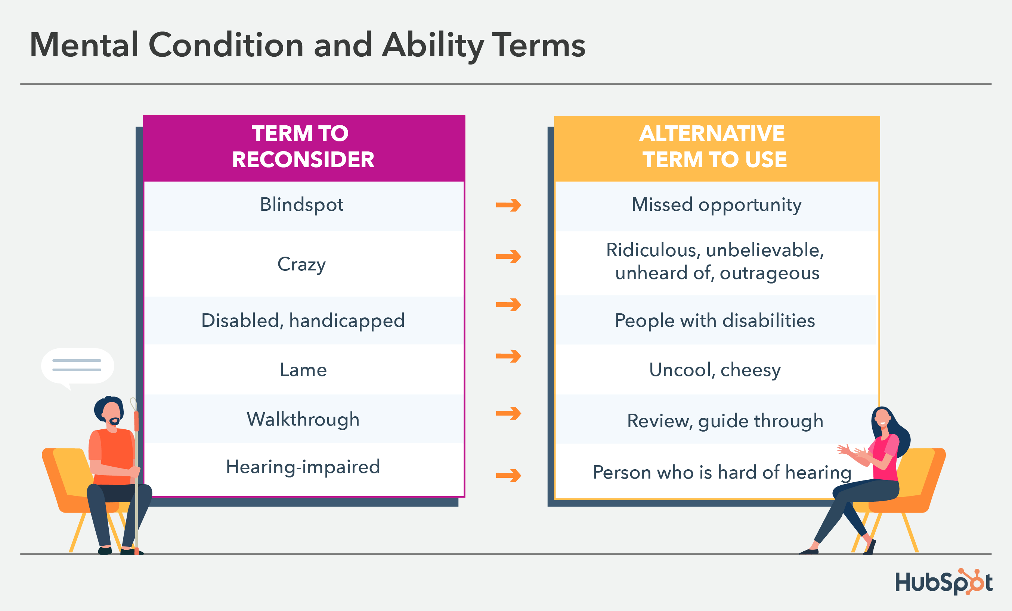

Slide 22
ASK FIRST
When in doubt, ask individuals which pronouns they prefer (but make it clear they can choose not to identify, as well).
people have personal preferences, especially when it comes to identity
person-first language (i.e., "people with autism") was introduced because many feel it's dehumanizing to put the disability or gender orientation first, as it seems to define the individual

Slide 23
Technical Writing Process
Planning
Drafting
Revising
Editing

Slide 24
Technical Writing Process
Planning
Planning is the initial phase of the technical writing process where writers define the purpose, audience, scope, and objectives of the document.
Writers identify the key messages, information to be included, and the overall structure of the document during the planning stage.
Considerations such as the target audience's knowledge level, expectations, and needs are crucial in planning the content and tone of the document.
Establishing a clear outline, defining the main sections, and organizing the information effectively are essential steps in the planning phase of technical writing.

Slide 25
Technical Writing Process
Drafting:
Drafting involves putting the planned content into written form, creating the first version of the document.
Writers focus on translating ideas into coherent sentences and paragraphs, following the established outline and structure.
During the drafting phase, the emphasis is on getting the content down on paper without worrying too much about perfection or fine-tuning.
Writers may incorporate research findings, data, examples, and illustrations to support their points and enhance the clarity and credibility of the document.

Slide 26
Technical Writing Process
Revising:
Revising is a critical stage in the technical writing process where writers review and refine the content, structure, and organization of the document.
Writers assess the overall coherence, logic, and effectiveness of the document, making revisions to improve clarity, accuracy, and readability.
Revising involves reorganizing sections, clarifying complex ideas, eliminating redundancies, and ensuring that the content aligns with the document's purpose and audience.
Feedback from peers, subject matter experts, or editors can be valuable during the revision process to identify areas for improvement and enhance the quality of the document.

Slide 27
Technical Writing Process
Editing:
Editing is the final stage of the technical writing process focused on polishing the document for grammar, punctuation, spelling, style, and formatting.
Writers carefully review the document for errors, inconsistencies, and adherence to style guidelines, ensuring that the writing is clear, concise, and professional.
Editing involves checking for proper sentence structure, word choice, tone, and overall coherence to enhance the document's readability and impact.
Proofreading for typos, formatting issues, and adherence to citation guidelines is also part of the editing process to produce a polished and error-free final draft.

Slide 28
Visual Elements in Technical Writing
Use of Graphics
Charts and Graphs
Diagrams
Images

Slide 29
Visual Elements in Technical Writing
Use of Graphics:
Graphics play a crucial role in enhancing the clarity and effectiveness of technical documents by visually representing complex information.
Graphics can include illustrations, diagrams, charts, tables, maps, and other visual aids that help convey information more efficiently than text alone.
By incorporating graphics strategically, technical writers can simplify concepts, highlight key points, and engage readers visually.
Graphics should be relevant, clear, and well-integrated into the text to support and enhance the written content.

Slide 30
Visual Elements in Technical Writing
Charts and Graphs:
Charts and graphs are commonly used visual elements in technical writing to present numerical data, trends, comparisons, and relationships.
Bar graphs, line graphs, pie charts, scatter plots, and other types of charts can help readers interpret data quickly and accurately.
Charts and graphs are effective for illustrating patterns, trends, correlations, and statistical information in a visually appealing and accessible format.
Proper labeling, scaling, and formatting are essential when creating charts and graphs to ensure clarity and accuracy in conveying information.

Slide 31
Visual Elements in Technical Writing
Diagrams:
Diagrams are visual representations of processes, systems, structures, relationships, or concepts that are difficult to explain through text alone.
Flowcharts, schematics, network diagrams, and other types of diagrams are valuable tools for illustrating complex ideas and workflows.
Diagrams help readers visualize how components interact, sequences of events, hierarchies, and spatial relationships in a clear and concise manner.
Well-designed diagrams can improve comprehension, aid in problem-solving, and enhance the overall readability of technical documents.

Slide 32
Visual Elements in Technical Writing
Images:
Images, photographs, illustrations, and screenshots can complement textual content in technical writing by providing visual context and examples.
Images can help readers visualize products, equipment, processes, locations, or concepts described in the text.
High-quality images that are relevant, clear, and properly captioned can enhance the reader's understanding and engagement with the material.
When using images in technical documents, it is important to ensure copyright compliance, proper attribution, and alignment with the document's purpose and audience.

Slide 33
Editing and Proofreading in Technical Writing
Grammar and Spelling
Formatting Checks
Consistency

Slide 34
Editing and Proofreading in Technical Writing
Grammar and Spelling:
Checking grammar and spelling errors is crucial in technical writing to maintain credibility and clarity.
Editors and proofreaders review the text for grammatical mistakes, such as subject-verb agreement, punctuation errors, verb tense consistency, and sentence structure.
Spelling errors, typos, and misuse of words should be identified and corrected to enhance the readability and professionalism of the document.
Tools like spell checkers, grammar checkers, and style guides can be used to assist in identifying and correcting grammar and spelling issues.

Slide 35
Editing and Proofreading in Technical Writing
Consistency:
Consistency in terminology, formatting, style, and language is important in technical writing to avoid confusion and maintain coherence.
Editors and proofreaders ensure that technical terms, abbreviations, acronyms, and symbols are used consistently throughout the document.
Consistent formatting of headings, lists, tables, figures, and citations helps improve the document's organization and visual appeal.
Checking for consistency in tone, voice, and writing style across sections of the document helps create a cohesive and professional presentation.

Slide 36
Editing and Proofreading in Technical Writing
Formatting Checks:
Formatting checks involve reviewing the document's layout, design elements, and overall presentation to ensure visual consistency and readability.
Editors and proofreaders check for proper alignment, spacing, margins, font styles, headings, subheadings, and numbering in the document.
Consistent use of fonts, font sizes, colors, and styles for headings, body text, and emphasis helps maintain a professional and polished appearance.
Checking for proper placement of graphics, tables, figures, captions, and other visual elements is essential to ensure they enhance the content and are correctly referenced in the text.

Slide 37
Examples of Technical Writing
Sample Reports
Instruction Manuals
Proposals

Slide 38
Editing and Proofreading in Technical Writing
Sample Reports:
Technical reports are common examples of technical writing that present findings, analyses, and recommendations on a specific topic or project.
Sample reports may include research reports, feasibility studies, progress reports, incident reports, and scientific reports.
These reports typically follow a structured format with sections such as an executive summary, introduction, methodology, results, discussion, conclusions, and recommendations.
Sample reports demonstrate the ability to communicate complex technical information clearly and concisely to inform decision-making and problem-solving.

Slide 39
Editing and Proofreading in Technical Writing
Instruction Manuals:
Instruction manuals are another common type of technical writing that provides step-by-step guidance on how to use a product, operate equipment, or perform a task.
Sample instruction manuals may include user guides, installation manuals, troubleshooting guides, maintenance manuals, and training materials.
These manuals are designed to be user-friendly, with clear instructions, diagrams, illustrations, and safety precautions to help users understand and follow procedures effectively.
Instruction manuals demonstrate the ability to convey technical information in a structured and accessible format to assist users in achieving specific objectives.

Slide 40
Editing and Proofreading in Technical Writing
Proposals:
Technical proposals are persuasive documents that outline a plan, solution, or recommendation for a specific project, product, or service.
Sample proposals may include project proposals, research proposals, business proposals, grant proposals, and engineering proposals.
These proposals typically include sections such as an executive summary, introduction, problem statement, objectives, methodology, budget, timeline, and conclusion.
Proposals aim to convince stakeholders, clients, or funding agencies of the feasibility, benefits, and value of the proposed idea or initiative through clear and compelling technical writing.

Slide 41
TECHNICAL WRITING
VS
CREATIVE WRITING
HS 513

Slide 42
In the heart of a bustling city, where the neon lights danced with the shadows of the night, a lone figure stood on the edge of a rooftop, gazing at the sea of twinkling stars above. The cool breeze whispered secrets of forgotten dreams, carrying the scent of possibility and change. With each breath, the city's symphony of sounds faded into a distant hum, leaving only the rhythmic beat of a restless heart.
The innovative AI-powered system seamlessly integrates data analytics and machine learning algorithms to optimize operational efficiency and enhance decision-making processes.
By leveraging real-time insights and predictive modelling, the platform streamlines workflow automation identifies key performance indicators and mitigates potential risks proactively.

Slide 43
Purpose
CREATIVE
TECHNICAL
Creative writing focuses on expressing emotions, ideas, and stories in an imaginative and artistic way.
The primary goal of creative writing is to entertain, evoke emotions, or convey a message through storytelling, poetry, fiction, or personal essays.
Technical writing aims to convey complex information, instructions, or concepts in a clear, concise, and structured manner.
The primary goal of technical writing is to inform, instruct, or explain technical subjects to a specific audience.

Slide 44
Language
CREATIVE
TECHNICAL
Imagery and Figurative Language:
Creative Writing: In creative writing, authors often use vivid imagery, metaphors, similes, and other figurative language to evoke emotions and create a sensory experience for the reader.
Clarity and Conciseness
Technical Writing: Technical writing focuses on clarity and precision, using straightforward language and avoiding excessive use of figurative language to ensure that information is conveyed accurately and objectively.

Slide 45
Vocabulary
CREATIVE
TECHNICAL
Creative writing allows for a broader range of vocabulary choices, including literary and expressive language that may not have a specific technical meaning.
Technical writing requires the use of specialized terminology and jargon relevant to the specific field or subject matter being discussed to ensure clarity and accuracy in communication.

Slide 46
Vocabulary
Normal Writings
Technical Writings
Discover
Explain
Show
Think
Tell
Find
Look
Talk
Use
Get
Identify
Clarify
Demonstrate
Consider
Inform
Locate
Examine
Communicate
Utilize
Obtain

Slide 47
Vocabulary
Normal Writings
Technical Writings
Understand
Describe
Discuss
Choose
Ask
Remember
Start
Finish
Help
Create
Comprehend
Outline
Deliberate
Select
Inquire
Recall
Initiate
Conclude
Assist
Generate

Slide 48
Vocabulary- PHRASES
Normal Writings
Technical Writings
Figure out
Put together
Look into
Come up with
Get rid of
Take care of
Find out
Go over
Set up
Think about
Determine
Assemble
Investigate
Develop
Eliminate
Address
Ascertain
Review
Establish
Consider

Slide 49
TONE
CREATIVE
TECHNICAL
Creative writing allows for a more subjective and expressive tone, with authors using their unique voice and style to convey emotions, perspectives, and storytelling elements.
maintains an objective and formal tone, focusing on conveying information accurately and professionally without personal opinions or subjective interpretations, aiming for clarity and precision in communication.

Slide 50
Fill in the blanks
In order to ensure the proper functioning of the system, it is essential to conduct regular -----(a) to identify any potential issues. Once the -----(b)are identified, a detailed analysis should be performed to determine the root cause. It is important to -----(c) a comprehensive report outlining the findings and recommended actions. The next step is to implement the necessary -----(d) to address the issues and prevent future occurrences. Finally, a follow-up evaluation should be conducted to verify the effectiveness of the -----(e) measures taken.

Slide 51
One possible response
In order to ensure the proper functioning of the system, it is essential to conduct regular inspections to identify any potential issues. Once the problems are identified, a detailed analysis should be performed to determine the root cause. It is important to compile a comprehensive report outlining the findings and recommended actions. The next step is to implement the necessary solutions to address the issues and prevent future occurrences. Finally, a follow-up evaluation should be conducted to verify the effectiveness of the corrective measures taken.

Slide 52
THANK YOU

